Slide 1
Recurrent Neural Networks

Slide 2
Our Layers so far
Both Dense and Covnets we have used so far have had no memory. Each input shown to them is processed independently, with no state kept in between input. These are called feedforward networks.
In contrast, as you’re reading the present sentence, you’re processing it word by word—or rather, eye saccade by eye saccade—while keeping memories of what came before; this gives you a fluid representation of the meaning conveyed by this sentence.
A recurrent neural network adopts the same principle, it processes sequences by iterating through the sequence elements and maintaining a state containing information relative to what it has seen so far.

Slide 3
RNN: In simple words
The idea behind RNNs is to make use of sequential information. In a traditional neural network we assume that all inputs (and outputs) are independent of each other. But for many tasks that’s a very bad idea.
If you want to predict the next word in a sentence you better know which words came before it. RNNs are called recurrent because they perform the same task for every element of a sequence, with the output being depended on the previous computations.
Another way to think about RNNs is that they have a “memory” which captures information about what has been calculated so far

Slide 4
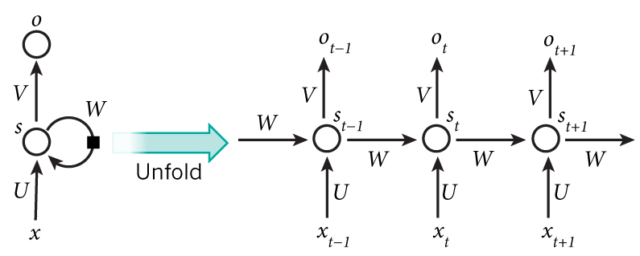
RNN
Notes:
x_t is the input at time step t. For example, x_1 could be a one-hot vector corresponding to the second word of a sentence. s_t is the hidden state at time step t. It’s the “memory” of the network. s_t is calculated based on the previous hidden state and the input at the current step: s_t=f(Ux_t + Ws_{t-1}). The function f usually is a nonlinearity such as tanh or ReLU. s_{-1}, which is required to calculate the first hidden state, is typically initialized to all zeroes. o_t is the output at step t. For example, if we wanted to predict the next word in a sentence it would be a vector of probabilities across our vocabulary. o_t = \mathrm{softmax}(Vs_t).

Slide 5
PseudoCode
state_t = 0 ← Initialized state for input_t in input_sequence: ← #The state at t Iterates over sequence elements ￼￼￼￼ output_t = f(input_t, state_t) state_t = output_t ← #The previous output becomes the state for the next iteration.
state_t = 0 for input_t in input_sequence: output_t = activation(dot(W, input_t) + dot(U, state_t) + b) state_t = output_t

Slide 6
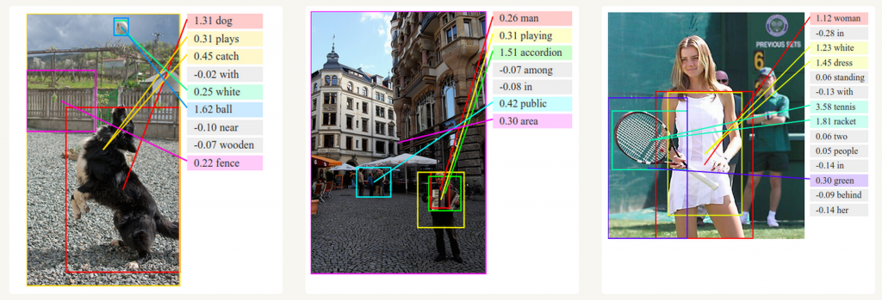
RNN: Use cases
Easy enough: in summary, an RNN is a for loop that reuses quantities computed during the previous iteration of the loop, nothing more.
So far, RNN have found greatest success in NLP and Language modelling. Together with convolutional Neural Networks, RNNs have also been used as part of a model to generate descriptions for unlabeled images.

Slide 7
Training RNNs: Tricky
Training a RNN is similar to training a traditional Neural Network. We also use the backpropagation algorithm, but with a little twist. Because the parameters are shared by all time steps in the network, the gradient at each output depends not only on the calculations of the current time step, but also the previous time steps. For example, in order to calculate the gradient at t=4 we would need to backpropagate 3 steps and sum up the gradients. This is called Backpropagation Through Time (BPTT).

Slide 8
RNN’s in Keras
The most common RNN layer in Keras is SimpleRNN .
Like all recurrent layers in Keras, SimpleRNN can be run in two different modes: it can return either the full sequences of successive outputs for each timestep (a 3D tensor of shape (batch_size, timesteps, output_features)) or only the last output for each input sequence (a 2D tensor of shape (batch_size, output_features)).
This is controlled by the return_sequences positional argument which accepts boolean values.

Slide 9
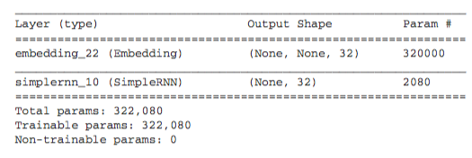
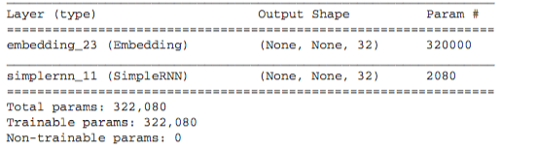
Which one is which?

Slide 10
RNN: Usage
It’s sometimes useful to stack several recurrent layers one after the other in order to increase the representational power of a network. In such a setup, you have to get all of the intermediate layers to return full sequence of outputs:
>>> model = Sequential() >>> model.add(Embedding(10000, 32)) >>> model.add(SimpleRNN(32, return_sequences=True)) >>> model.add(SimpleRNN(32, return_sequences=True)) >>> model.add(SimpleRNN(32, return_sequences=True)) >>> model.add(SimpleRNN(32)) >>> model.summary()

